Slide 1
Inheritance : Payroll application
In the payroll application, there are two types of employees
Commission employees are paid as a percentage of their sales. Base-salaried commission employees receive a base salary plus a percentage of their sales.
Object
CommissionEmployee
BasePlusCommissionEmployee

Slide 2
Inheritance : Payroll application(Cont.)
Detailed Class Diagram
Object
toString()
CommissionEmployee
first name
last name
social security number
gross sales
commission rate
get/set methods
earnings()
toString()
method
overriding
BasePlus
CommissionEmployee
base salary
earnings()
toString()
getBaseSalary()
setBaseSalary()
added
instance
variable
added
methods

Slide 3
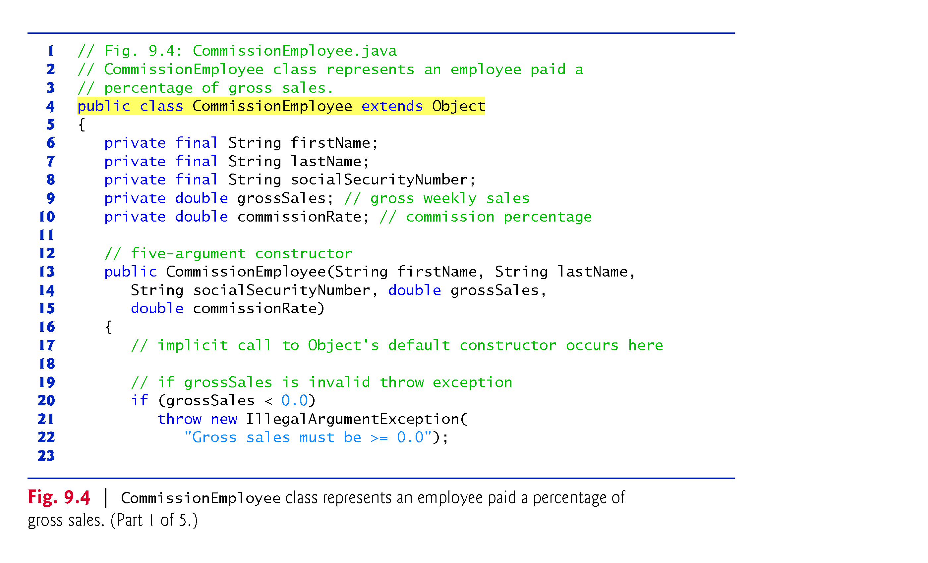
Example 1: CommissionEmployee (1/5): explicit extend
Object class is root of a class hierarchy. It can be added implicitly by compiler
It has no member field
It has only 11 methods
All subclasses implement methods of Object class .
Constructor is not inherited. But, constructor of subclass invoke Constructor of superclass implicitly as its first task

Slide 4
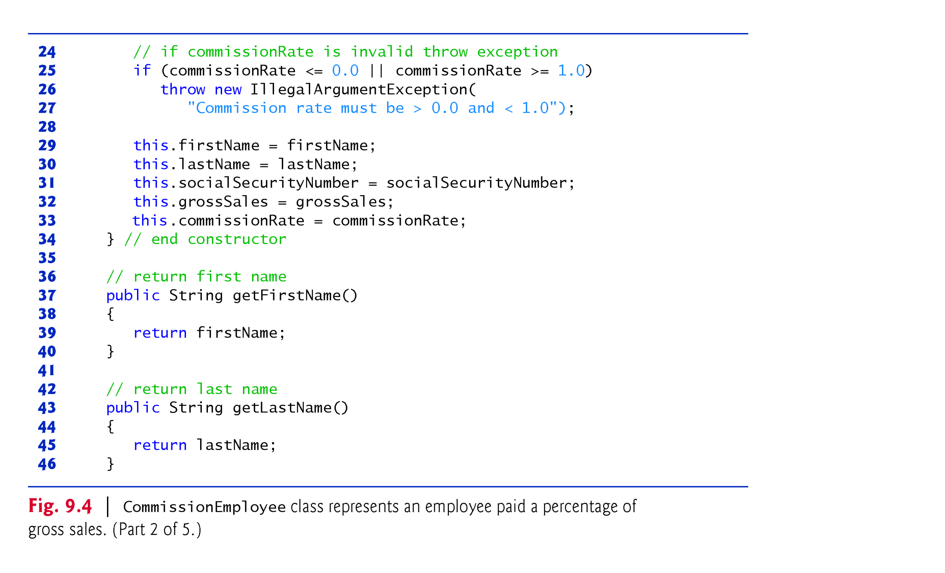
Example 1: CommissionEmployee Class(2/5): explicit extend

Slide 5
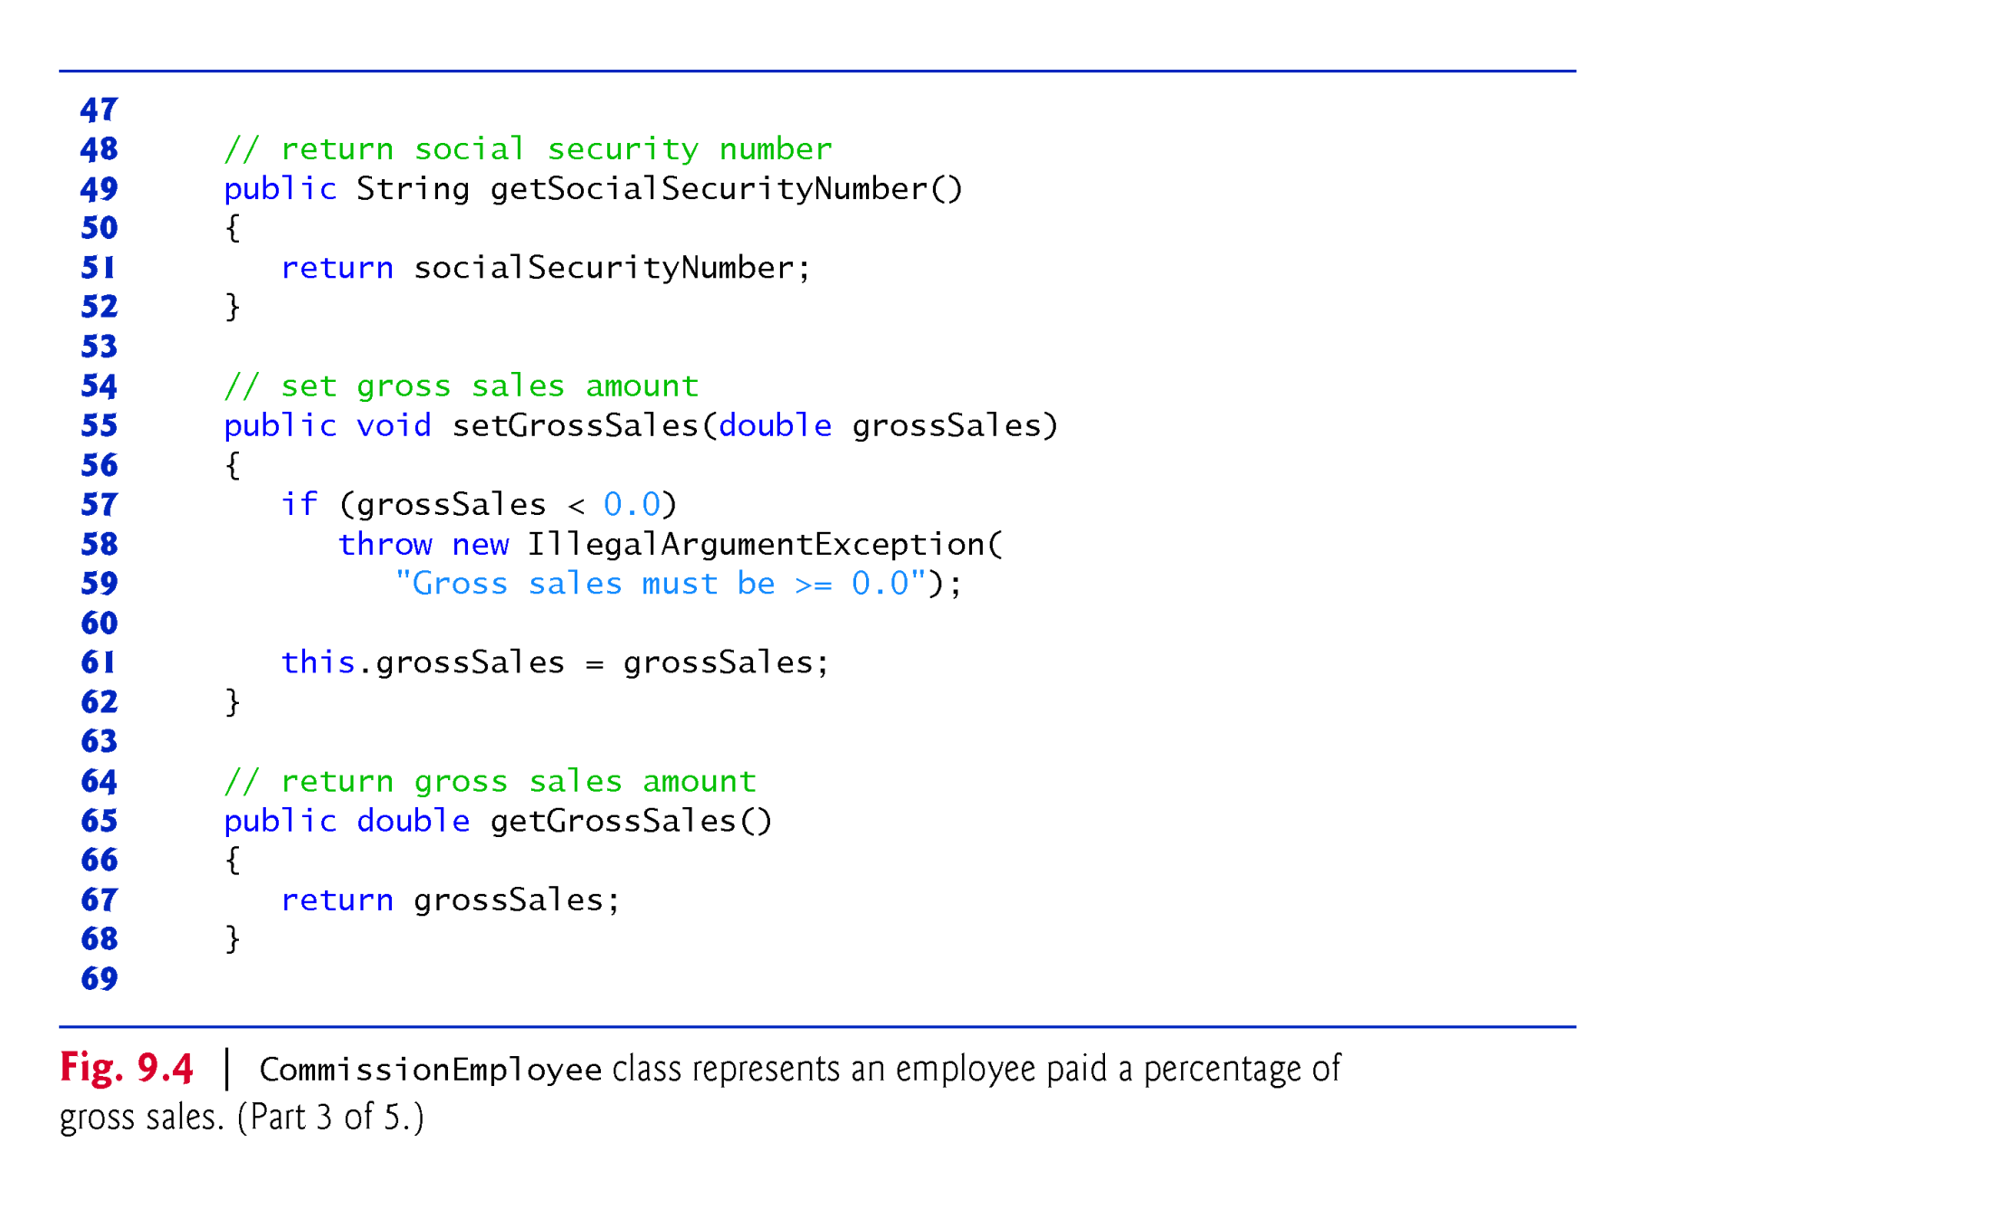
Example 1: CommissionEmployee Class(3/5):explicit extend

Slide 6
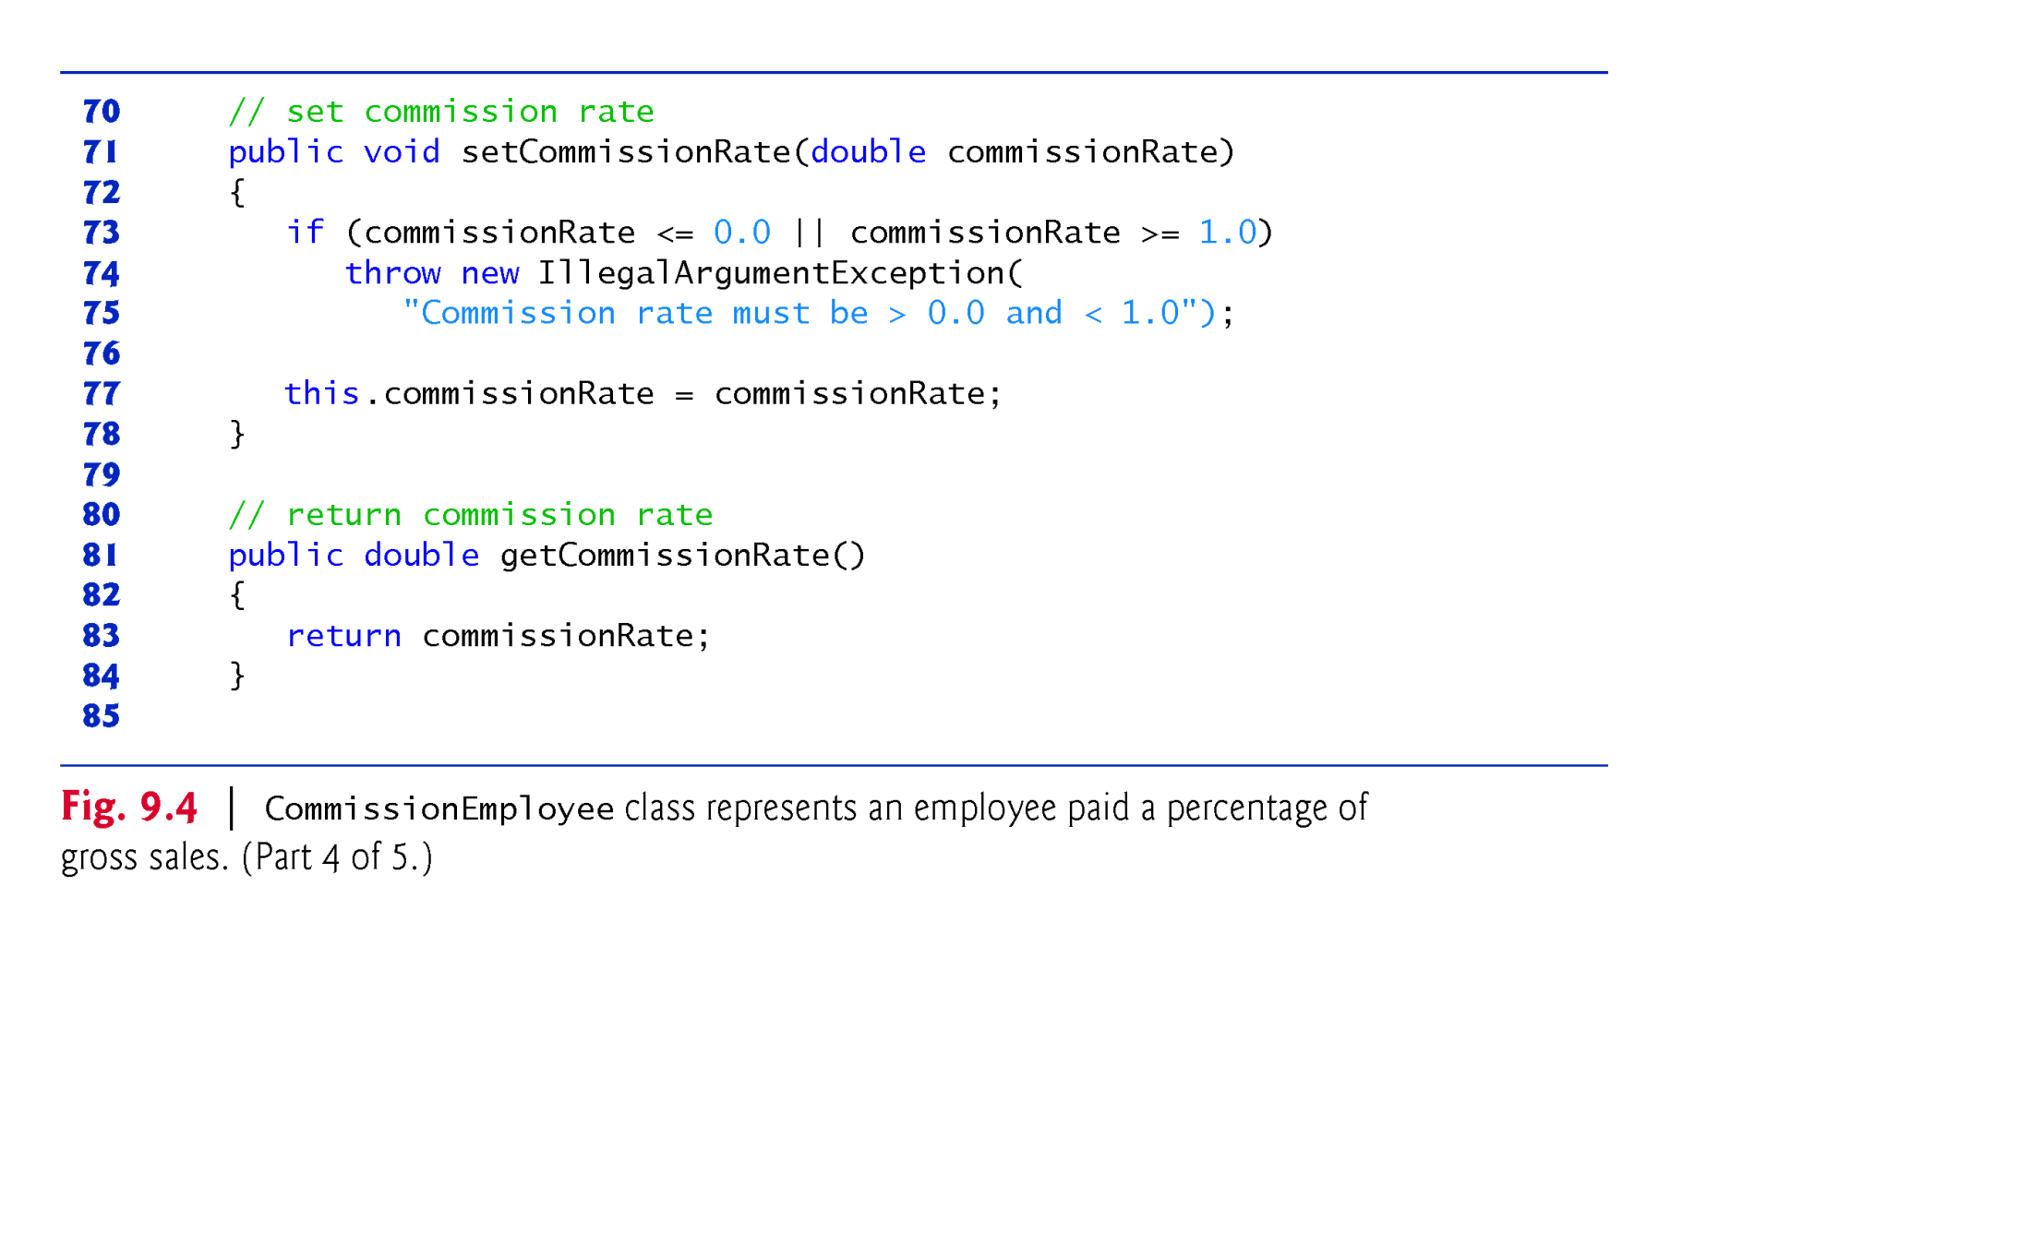
Example 1: CommissionEmployee Class(4/5):explicit extend

Slide 7
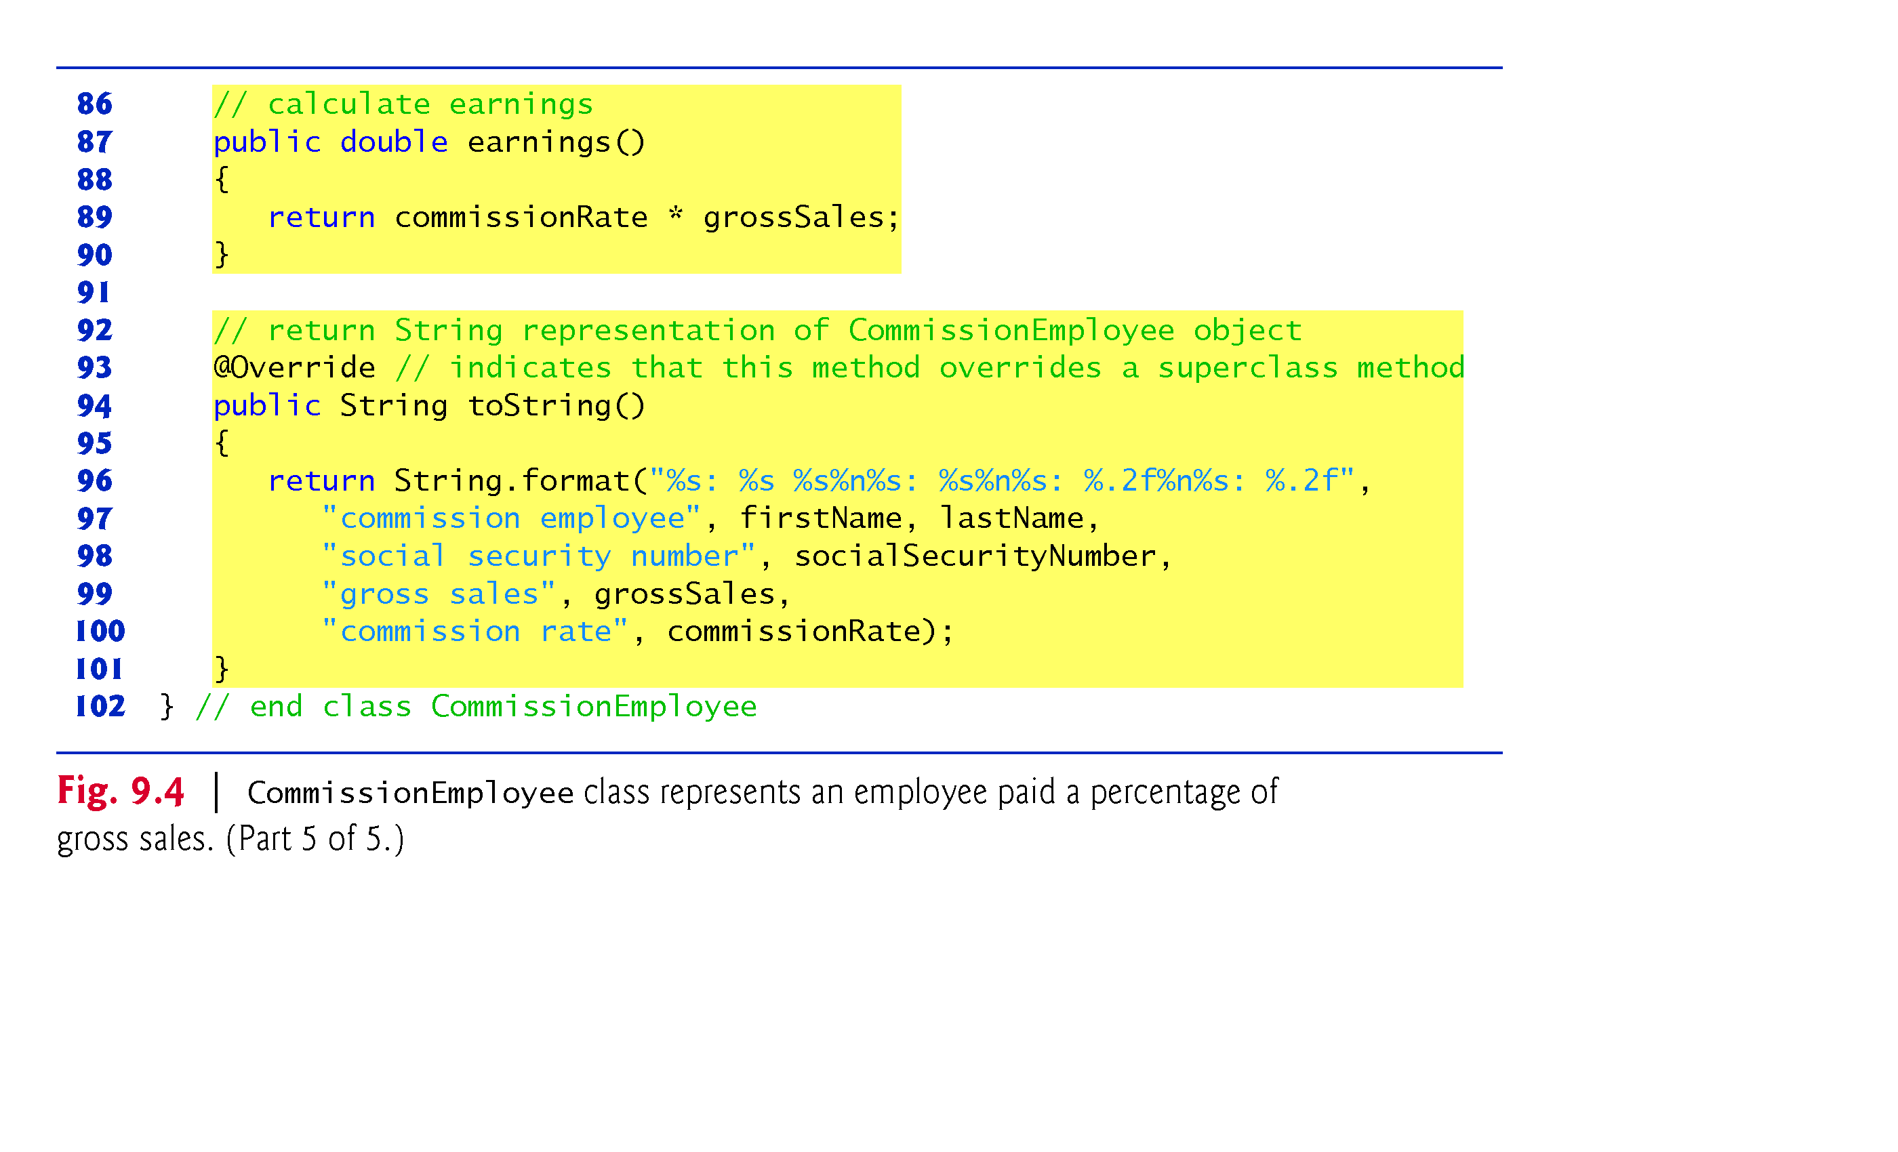
Example 1: CommissionEmployee Class(5/5): Explicit extend
3 Public Service methods: constructor, earnings(), toString()
5 Public getter methods: for 5 member fields
2 Public setter methods : for 2 member variable's, why not five?
Every class inherit tostring() from “Object” class directly or indirectly

Slide 8
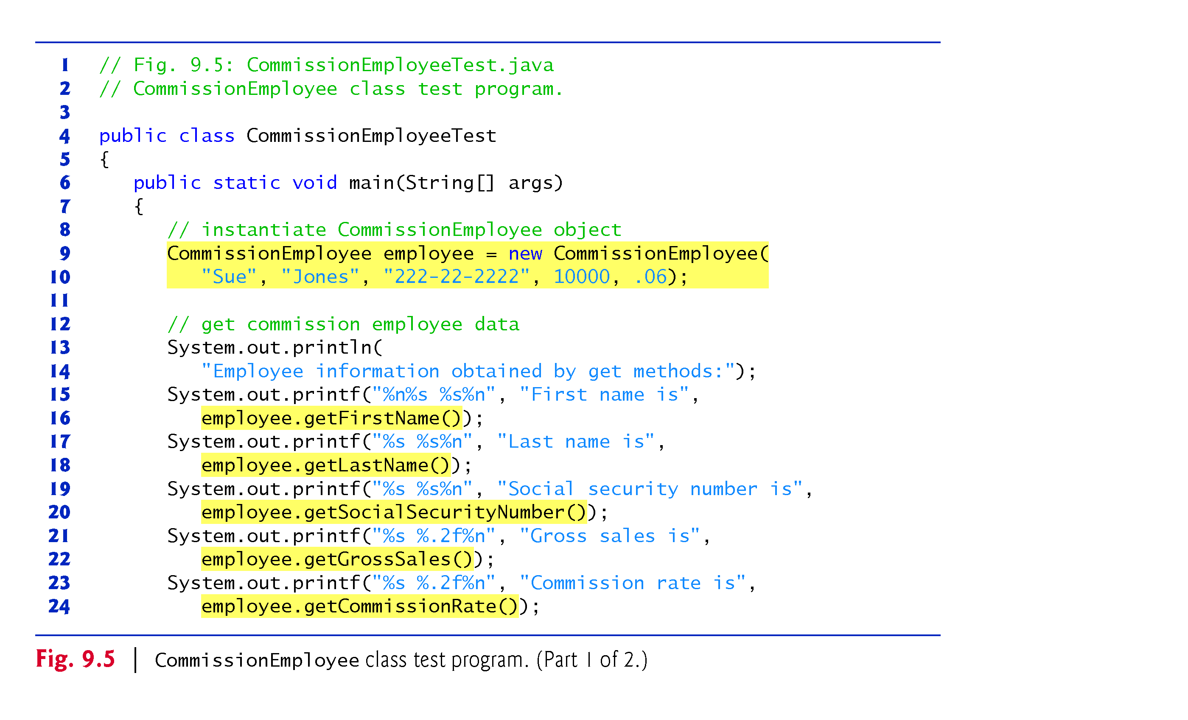
Example 1: CommissionEmployeeTest Class(1/2): explicit extend
Line 9 : CommissionEmploy() constructor invoke Object() constructor implicitly

Slide 9
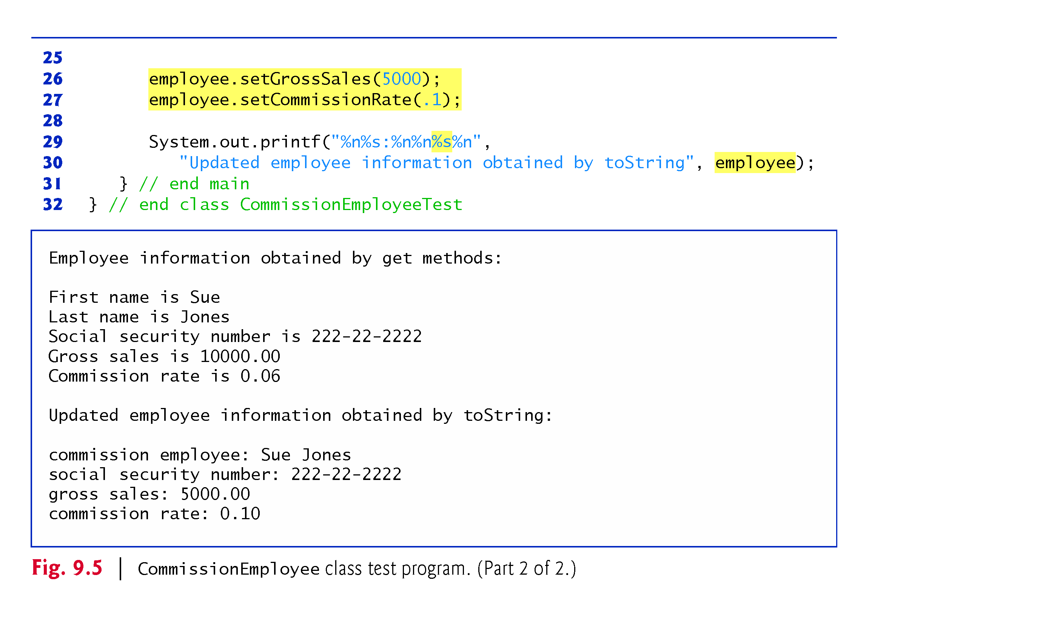
Example 1: CommissionEmployeeTest Class(2/2):Explicit extend
Line 30 :the toString() method is invoked implicitly as: employee.toString().

Slide 10
Example 2: BasePlus-CommissionEmployee Class
We can implement this class using two approaches
First: Without using inheritance principle. We create new and independent class
Second: Using Inheritance Principle(new and dependent class)
BasePlusCommissionEmployee
first name
last name
social security number
gross sales
commission rate
base salary
a constructor
get/set methods
earnings()
toString()

Slide 11
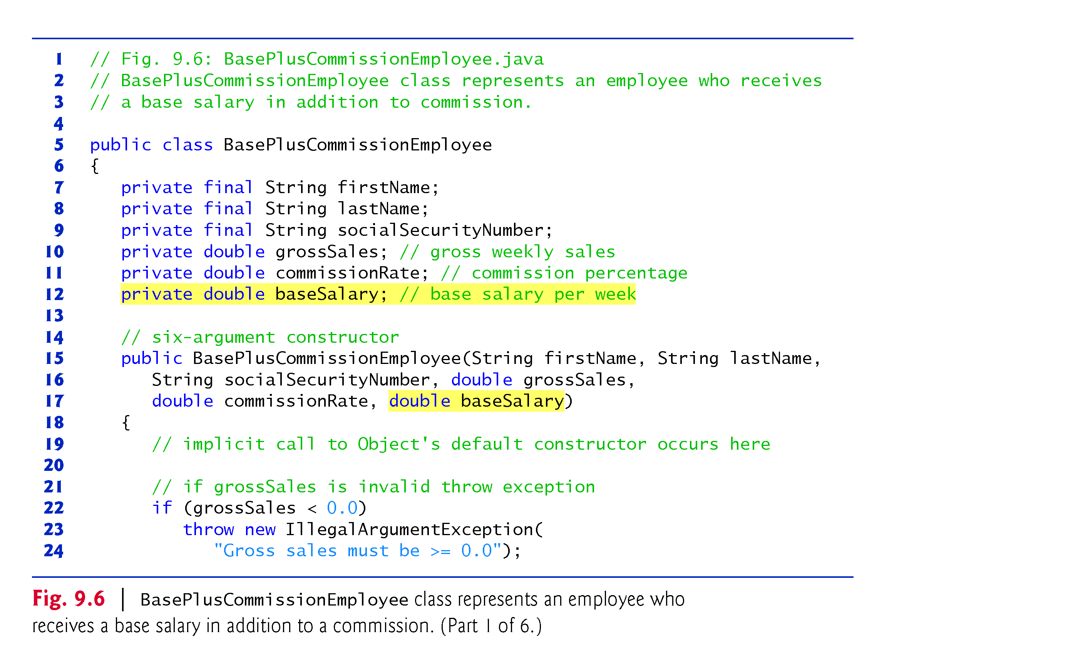
Example 2: BasePlusCommissionEmployee class: implicit extend, but without inheritance(1/6)
“Object “ class is extended implicitly
Subclass constructor invoke superclass constructor implicitly

Slide 12
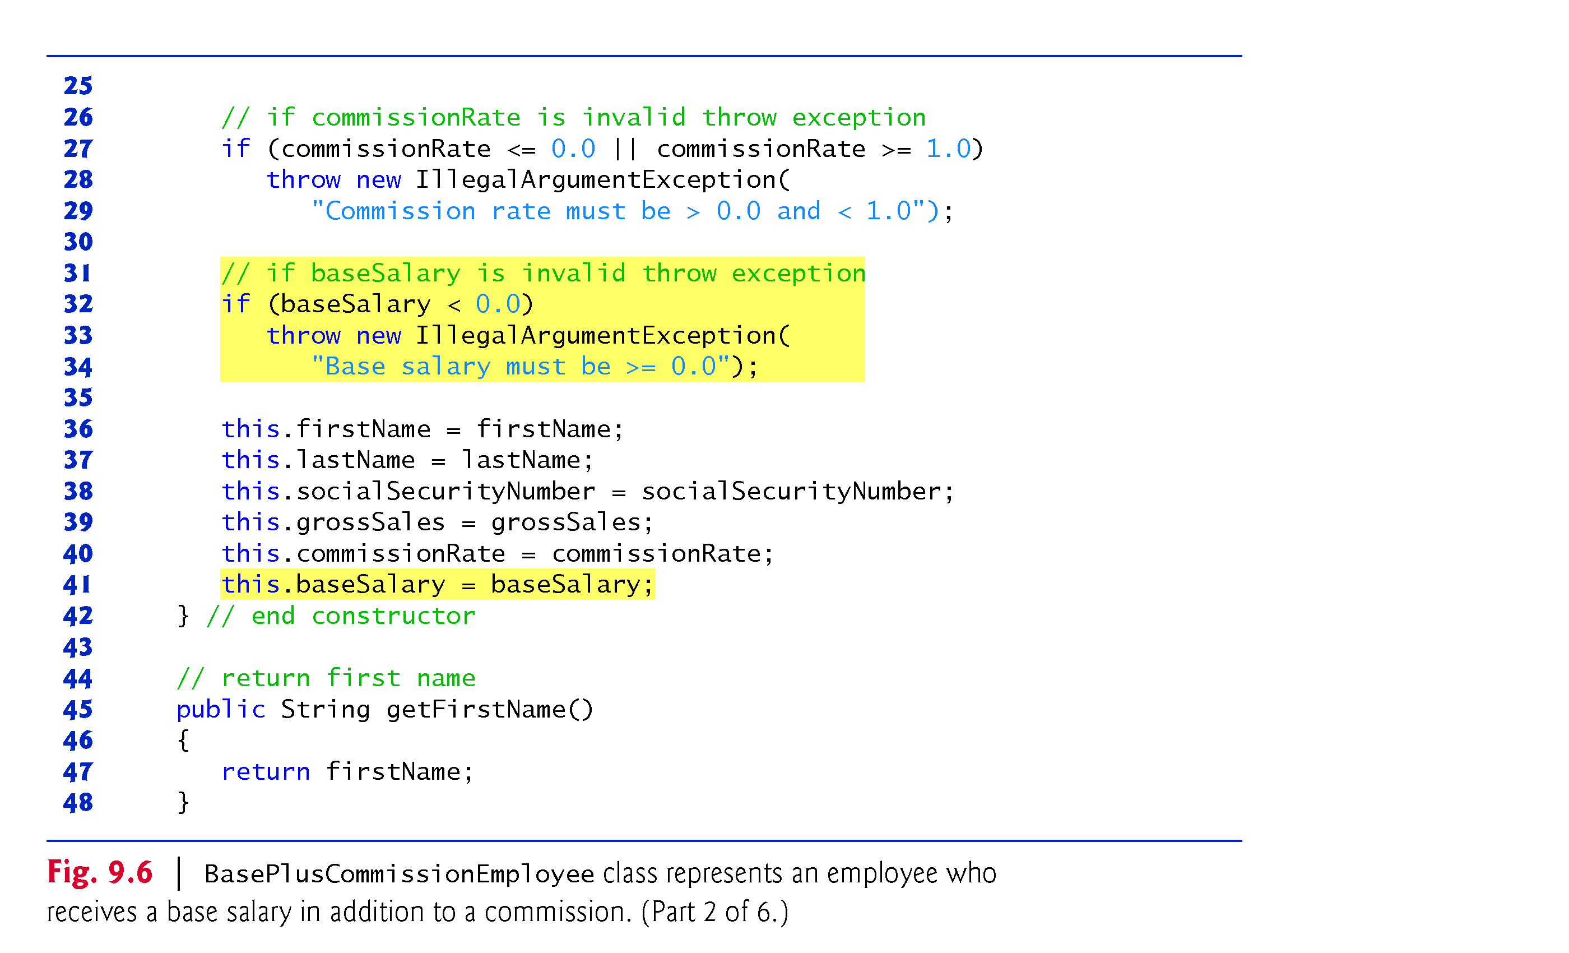
Example 2: BasePlusCommissionEmployee class: implicit extend, but without inheritance(2/6)

Slide 13
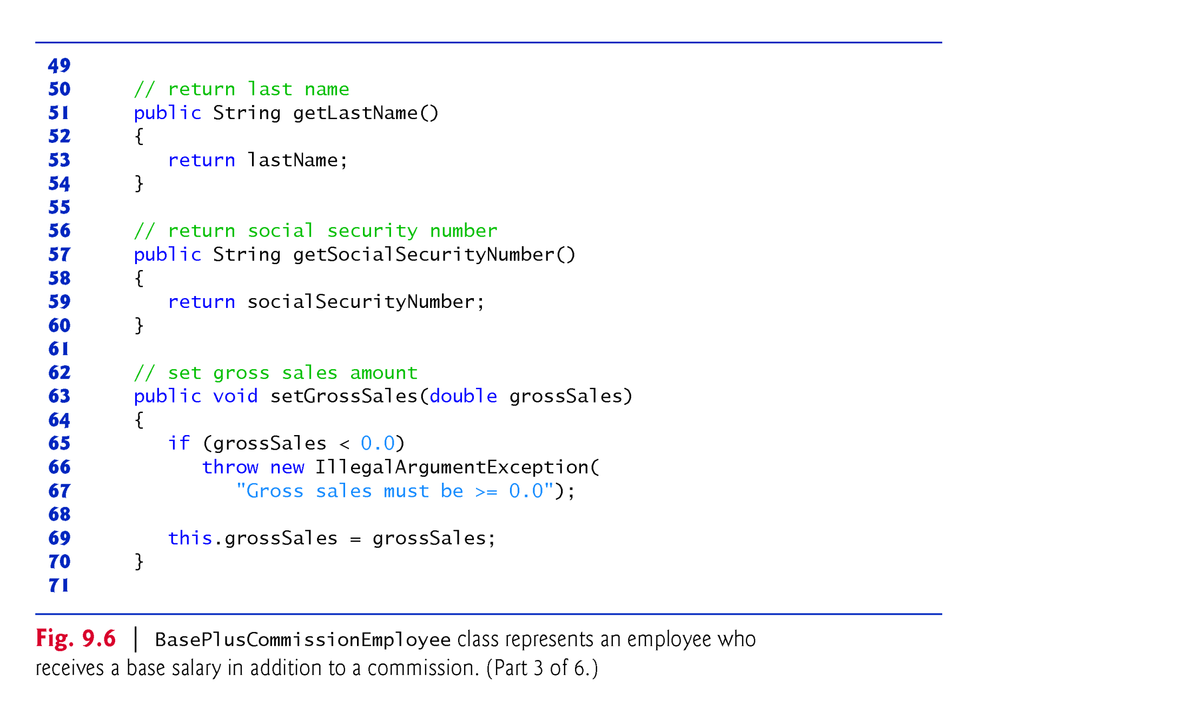
Example 2: BasePlusCommissionEmployee class: implicit extend, but without inheritance(3/6)

Slide 14
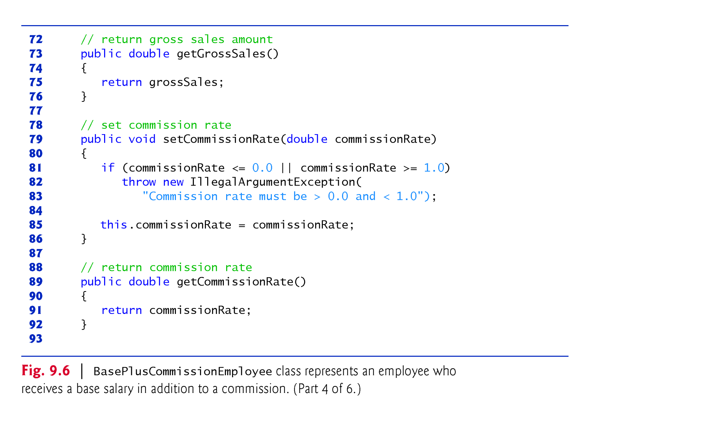
Example 2: BasePlusCommissionEmployee class: implicit extend, but without inheritance(4/6)

Slide 15
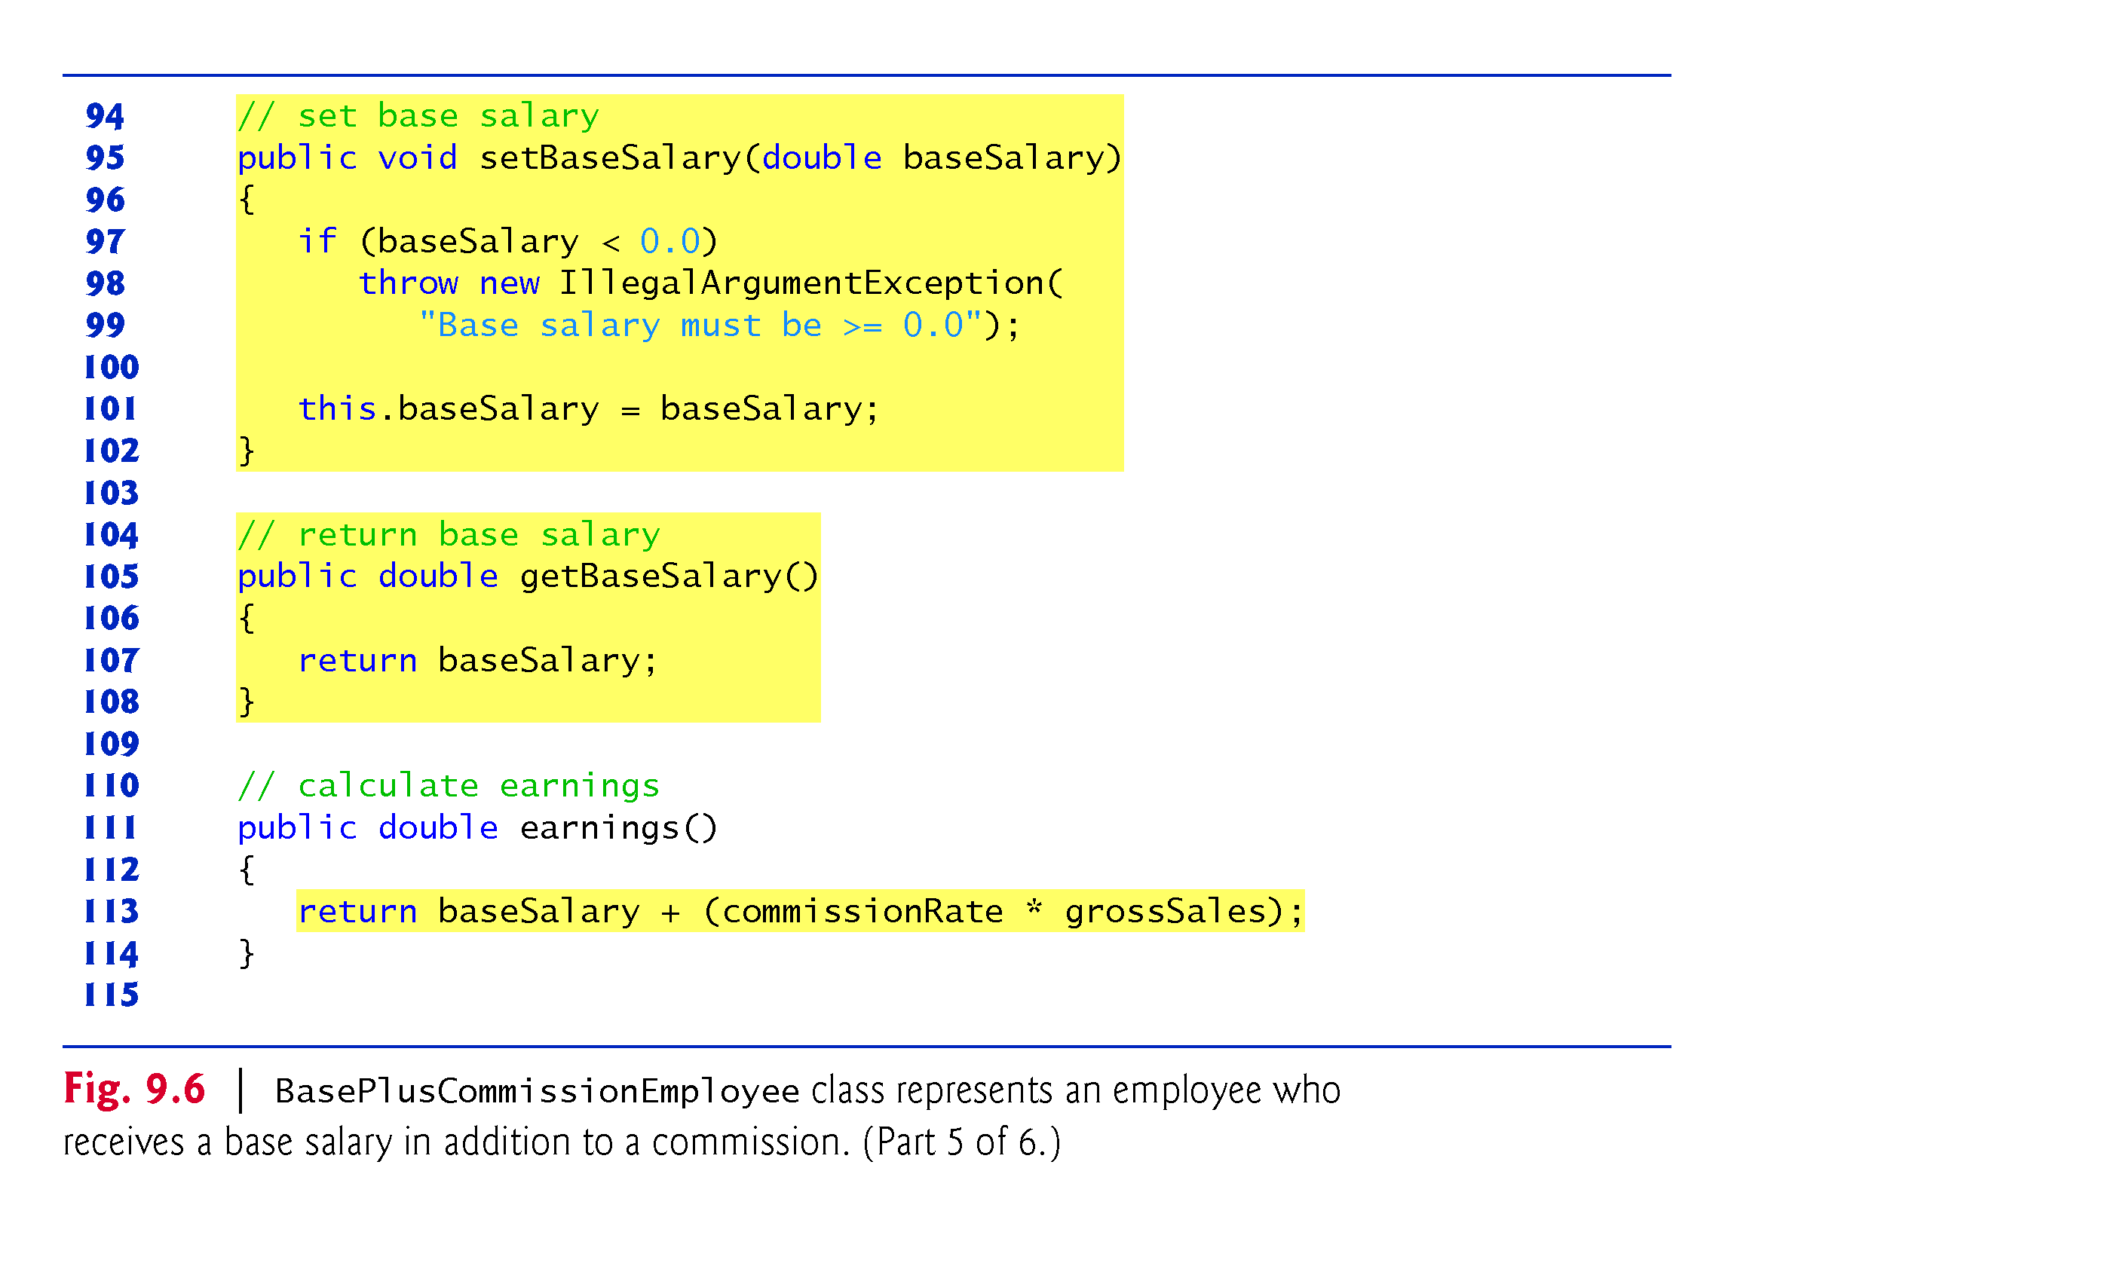
Example 2: BasePlusCommissionEmployee class: implicit extend, but without inheritance(5/6)

Slide 16
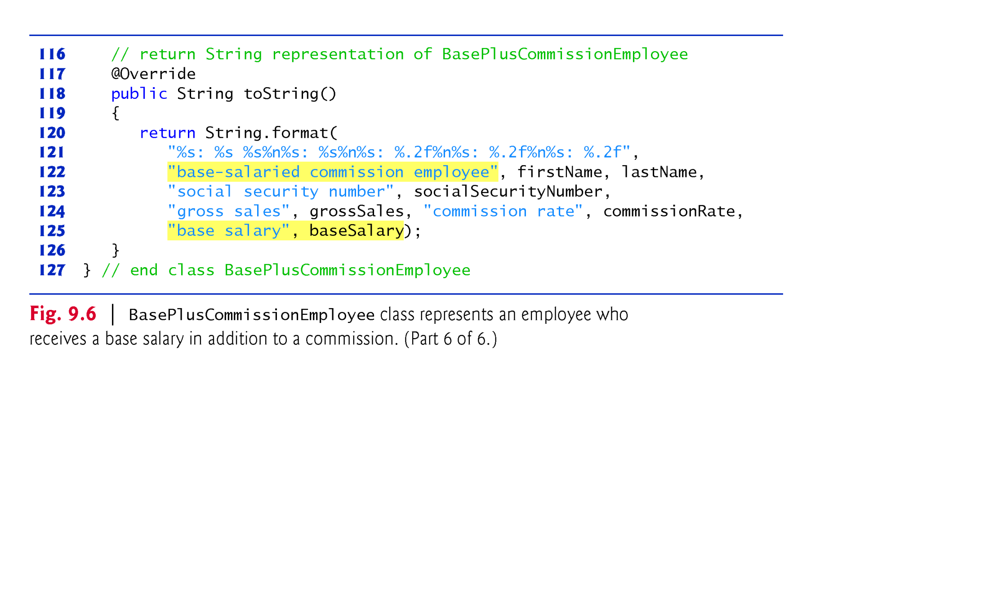
Example 2: BasePlusCommissionEmployee class: implicit extend, but without inheritance(6/6)

Slide 17
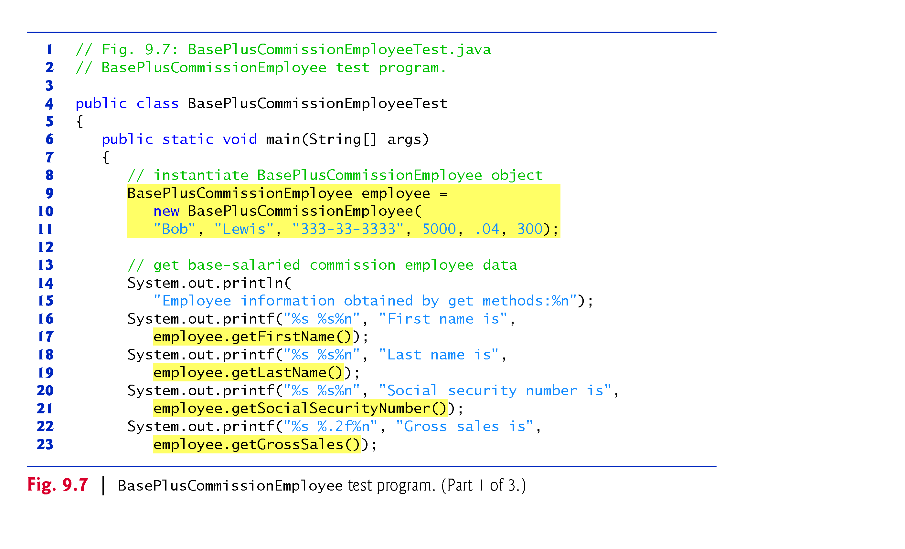
Example 2: BasePlusCommissionEmployeeTest class: implicit extend, but without inheritance(1/2)

Slide 18
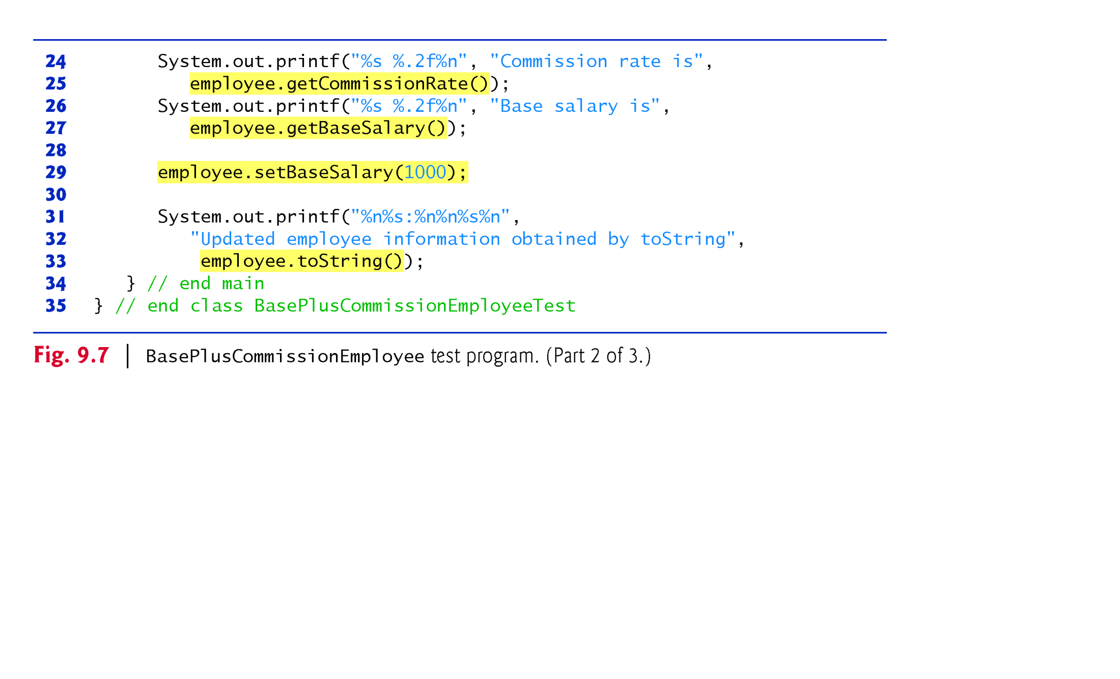
Example 2: BasePlusCommissionEmployeeTest class: implicit extend, but without inheritance(2/2)
Line 33 :System.out.printf(employee.toString()): // toString() is invoked explicitly
We can replace line 23 by:
System.out.printf(employee ); // toString() method is invoked implicitly.

Slide 19
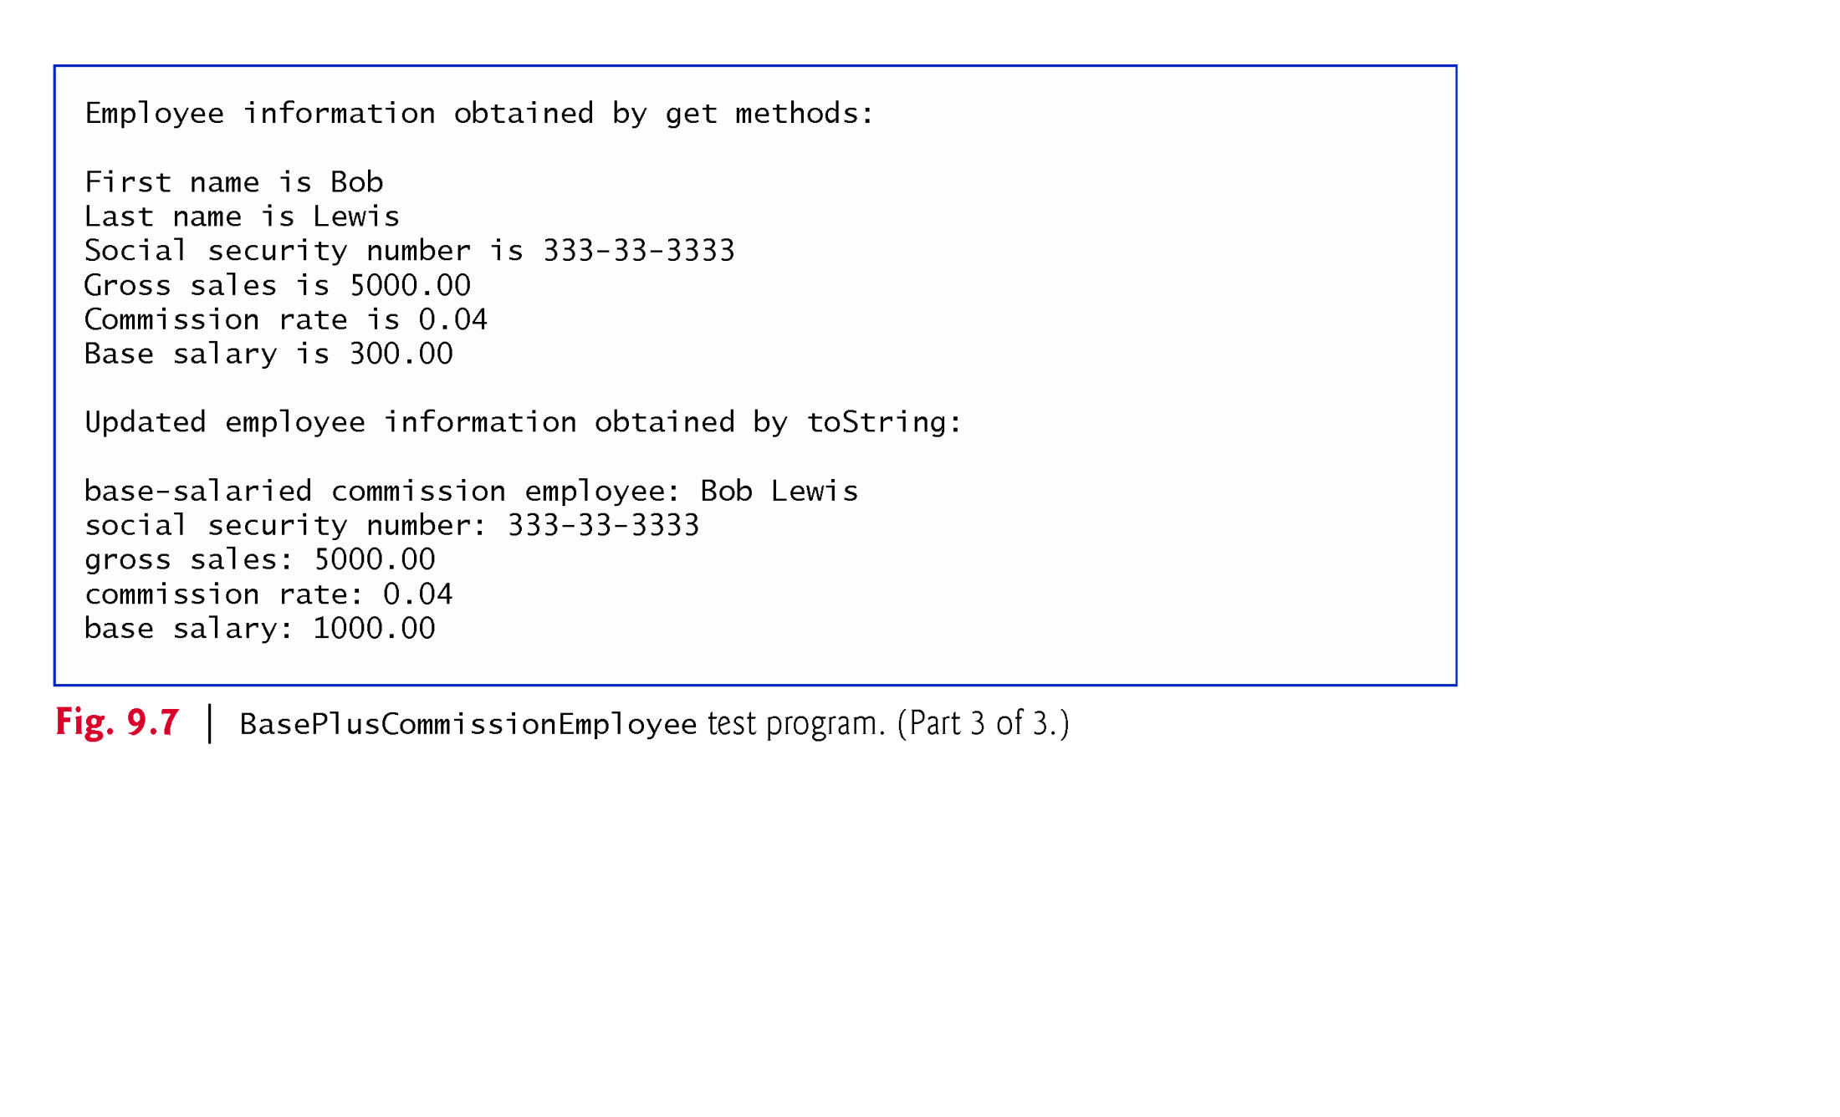
Example 2: Out put to Screen

Slide 20
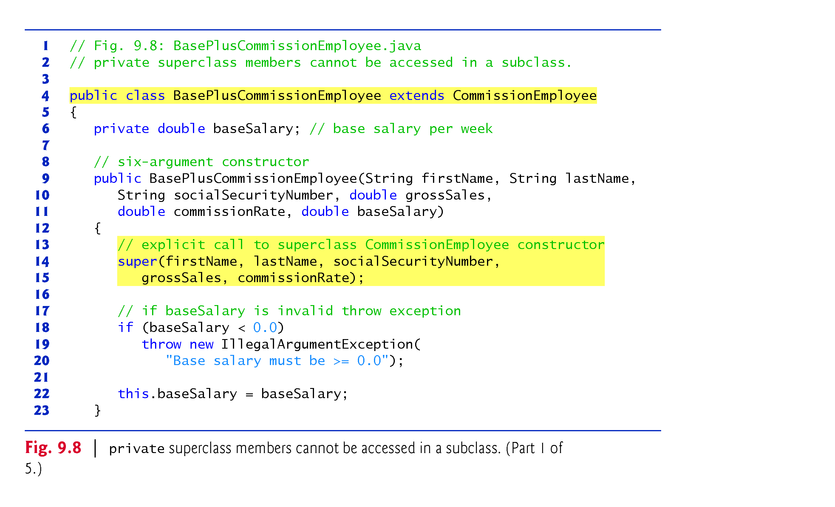
Example 3: BasePlusCommissionEmployee class: Inheritance(1/3)
Line 14: constructor of child class call constructor of parent class

Slide 21
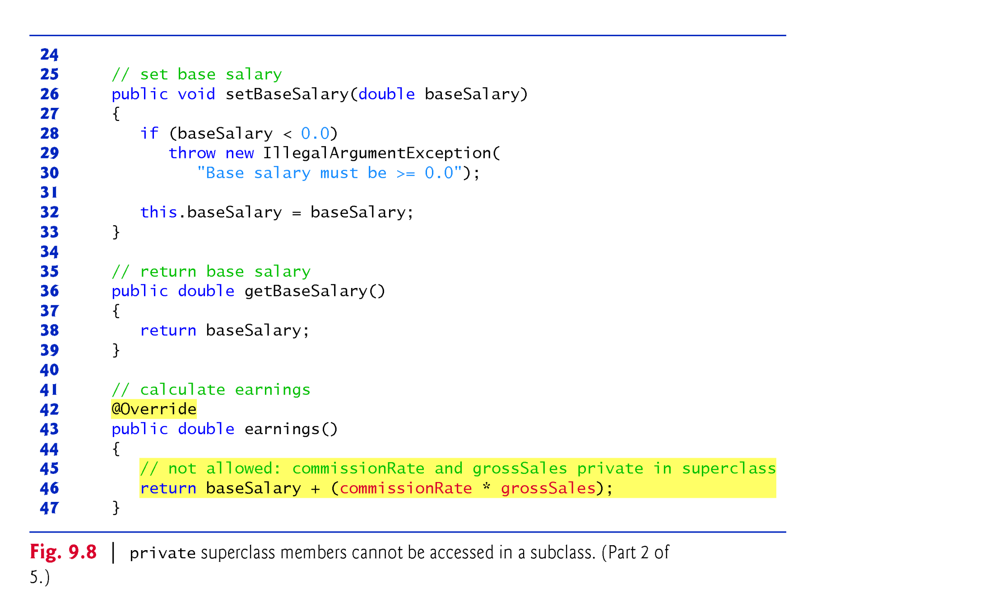
Example 3: BasePlusCommissionEmployee class: Inheritance(2/3)
Line 46 : Compilation error because subclass code cannot access(inherit) directly private members of superclass
Solution: Use public get() and set() methods

Slide 22
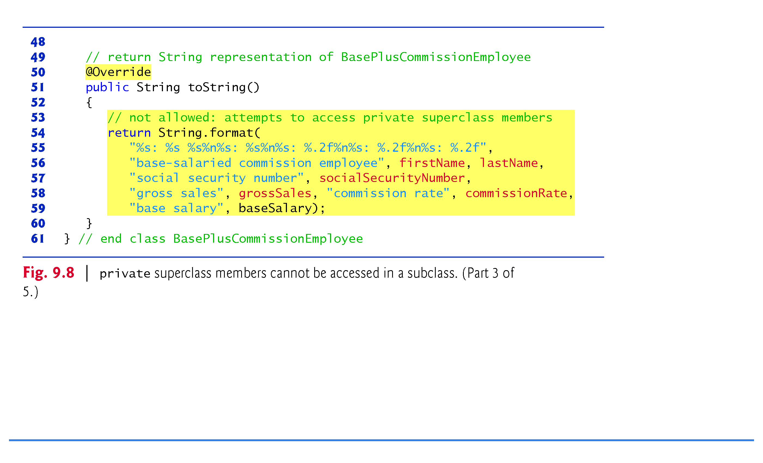
Example 3: BasePlusCommissionEmployee class: Inheritance(3/3)
Note: use figure 9.7 as test class:
Line 56-59 : Compilation error because subclass code cannot access(inherit) directly private members of superclass
Solution: Use public get() and set() methods

Slide 23
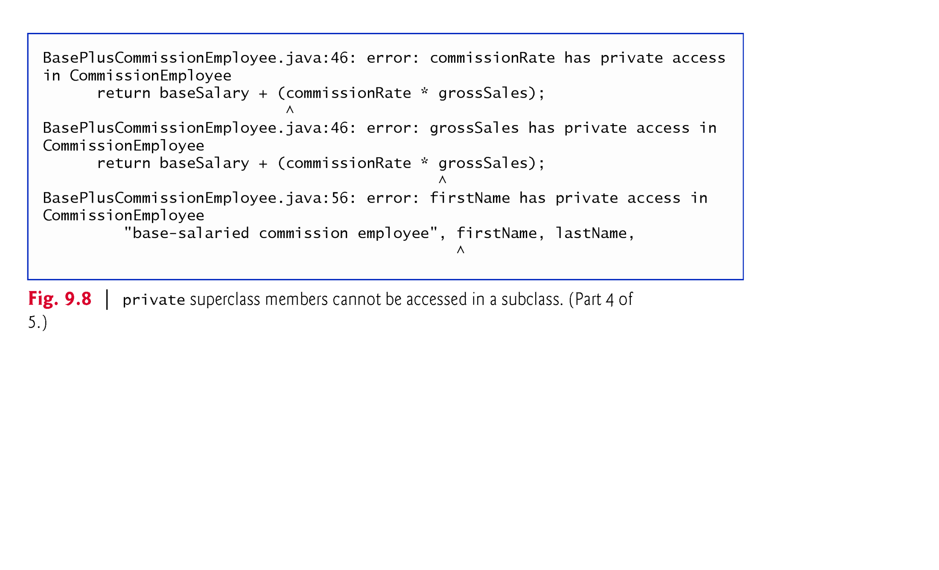
Example 3: Using fig.9.7 as test : Display Error.Why?

Slide 24

Example 3: Using fig.9.7 as test : Display Error.Why?

Slide 25
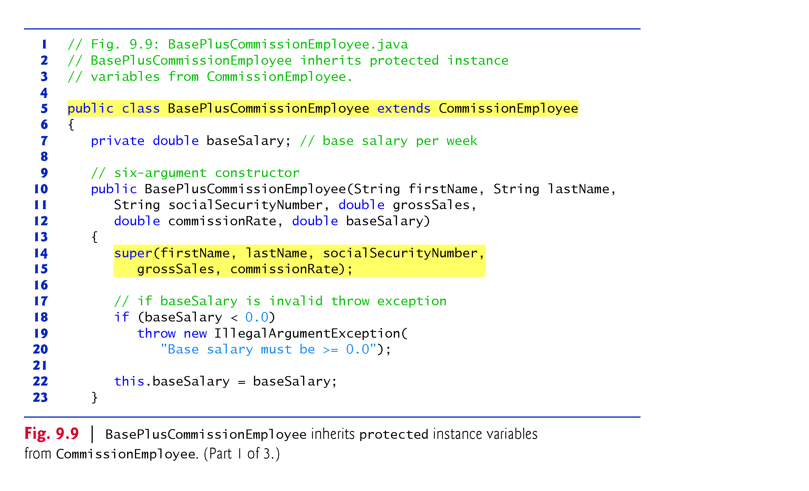
Exam 4: BasePlus: Inheritance + Protected(1/3)

Slide 26
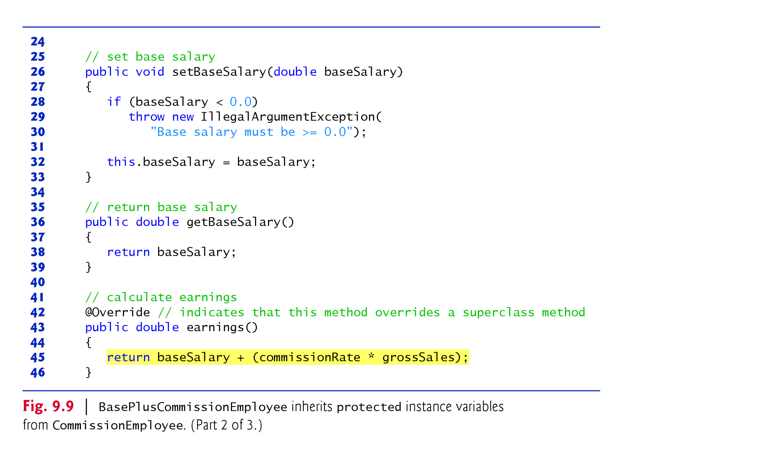
Exam 4: BasePlus: Inheritance + Protected(2/3)
Line 45 : No Compilation error because subclass(client code) can access(inherit) directly protected members of superclass

Slide 27
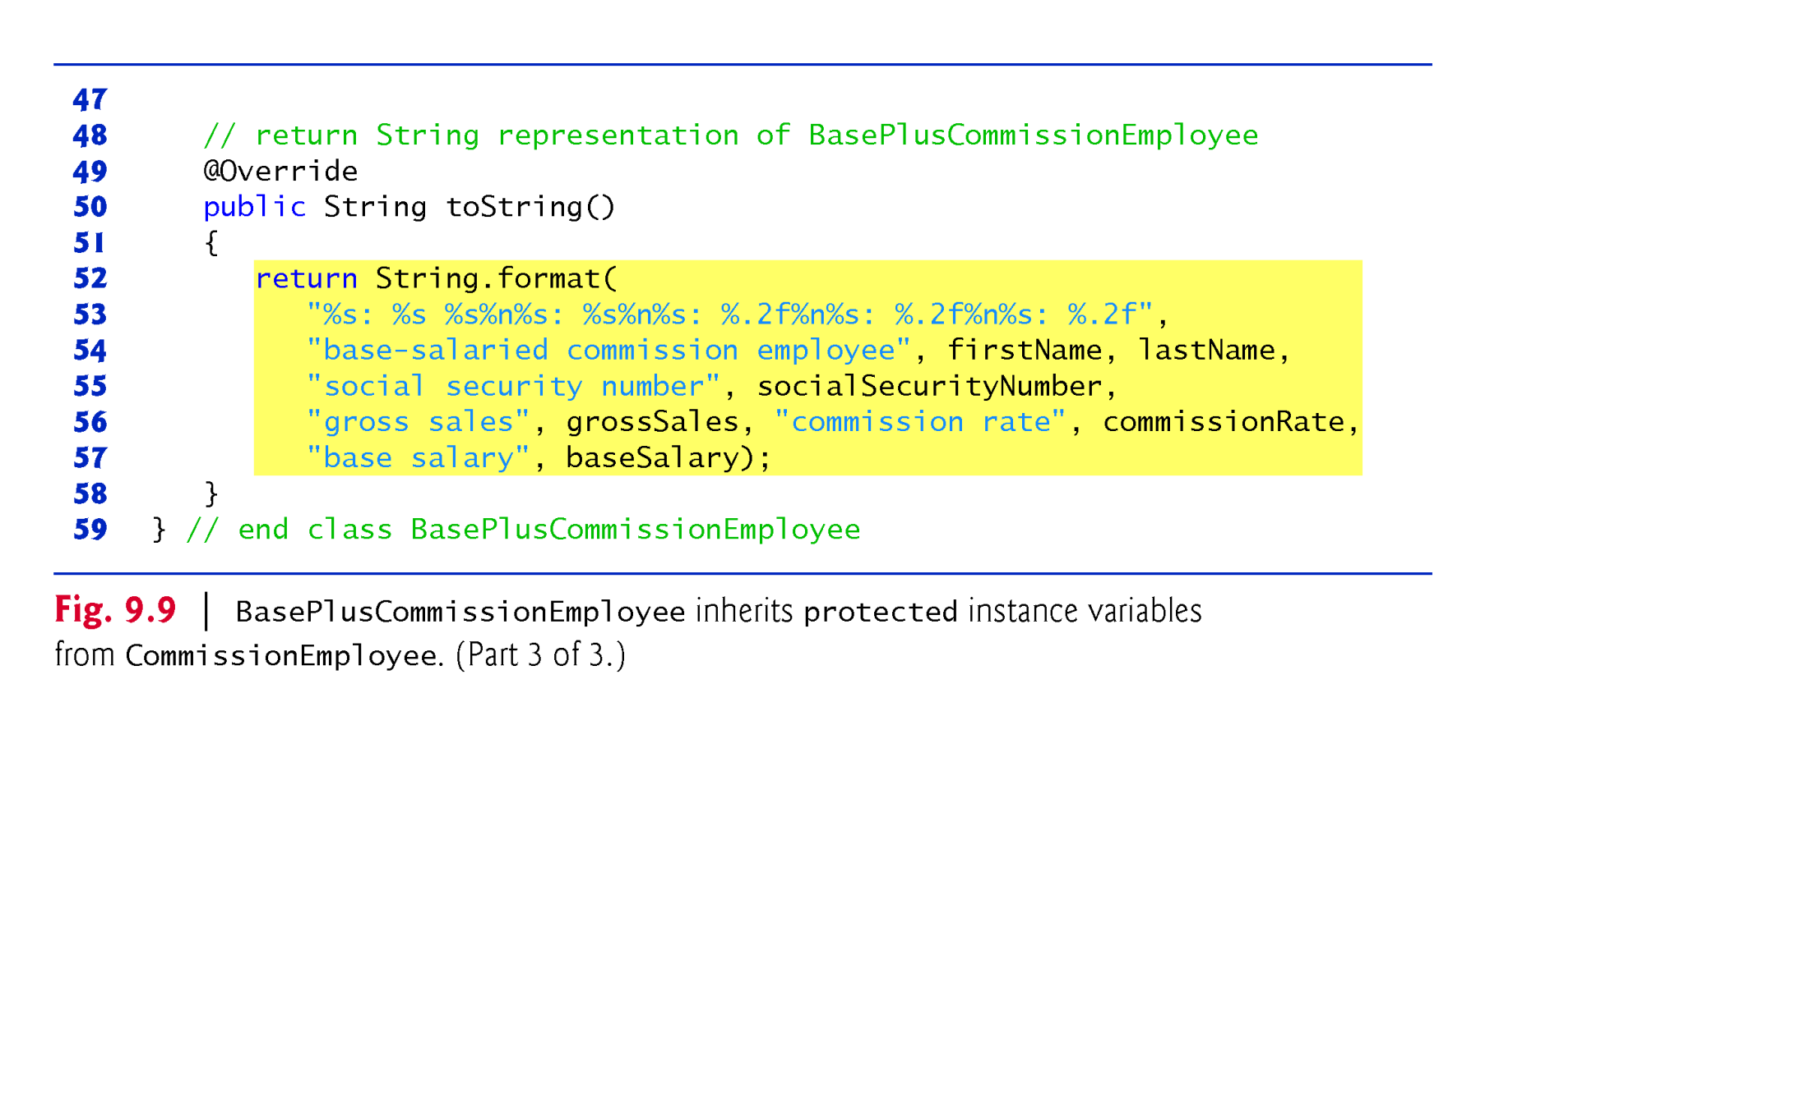
Exam 4: BasePlus: Inheritance + Protected(3/3)
Note: Figure 9.7 is used as test class

Slide 28
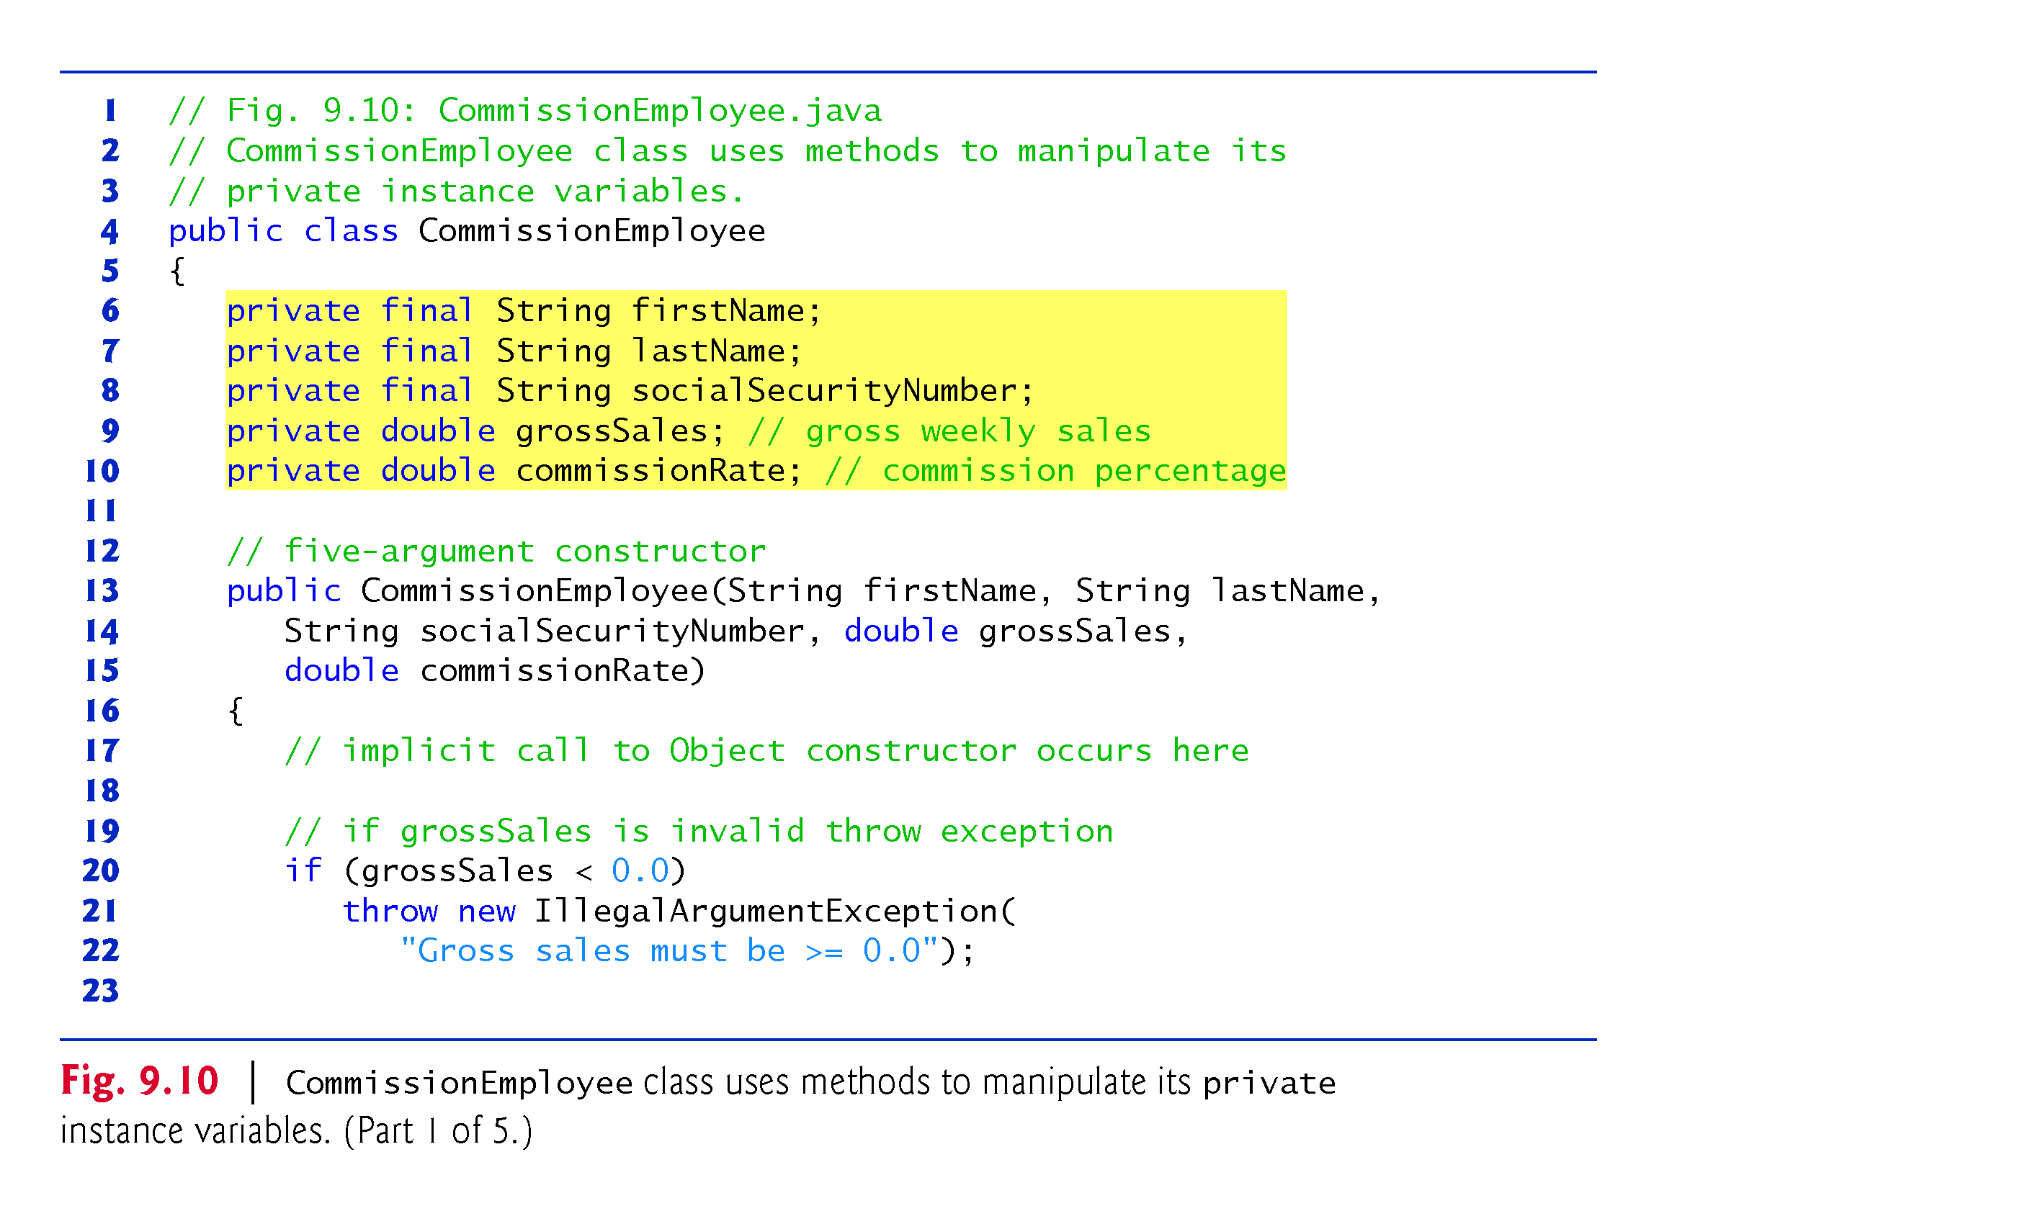
Example 5: BasePlus: Inheritance + Private(1/8)
Start of declaration of Supper class

Slide 29

Example 5: BasePlus: Inheritance + Private(2/8)

Slide 30

Example 5: BasePlus: Inheritance + Private(3/8)

Slide 31
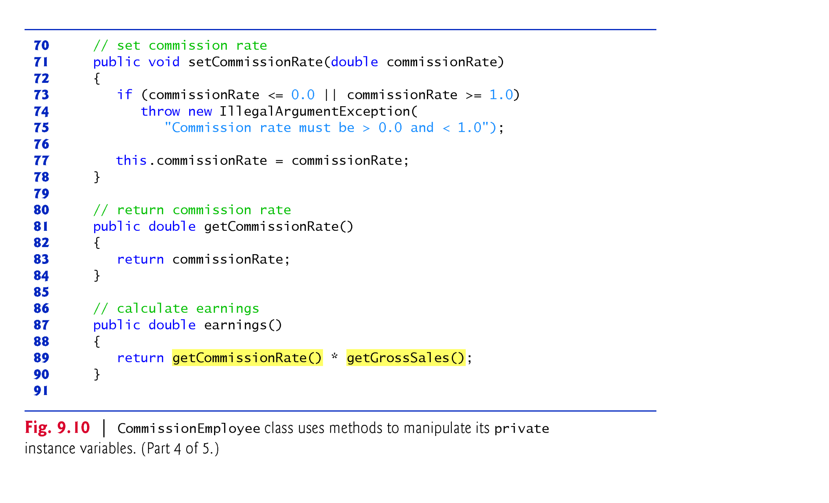
Example 5: BasePlus: Inheritance + Private(4/8)

Slide 32
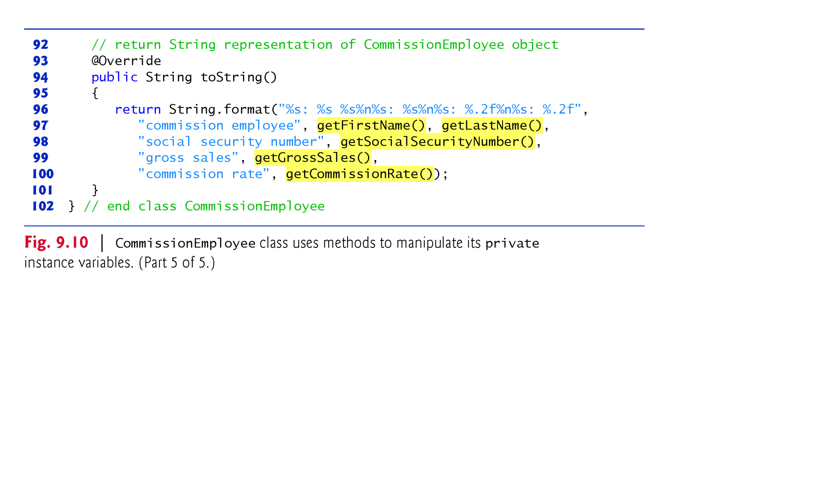
Example 5: BasePlus: Inheritance + Private(5/8)
End of declaration of Supper class
Line 94: toString() method override the toString () method of “Object”class (java.lang,Object)

Slide 33

Example 5: BasePlus: Inheritance + Private(6/8)
Start of declaration of Subclass
Line 15: sub-constructor invoke super constructor to initialize private members of superclass indirectly.

Slide 34
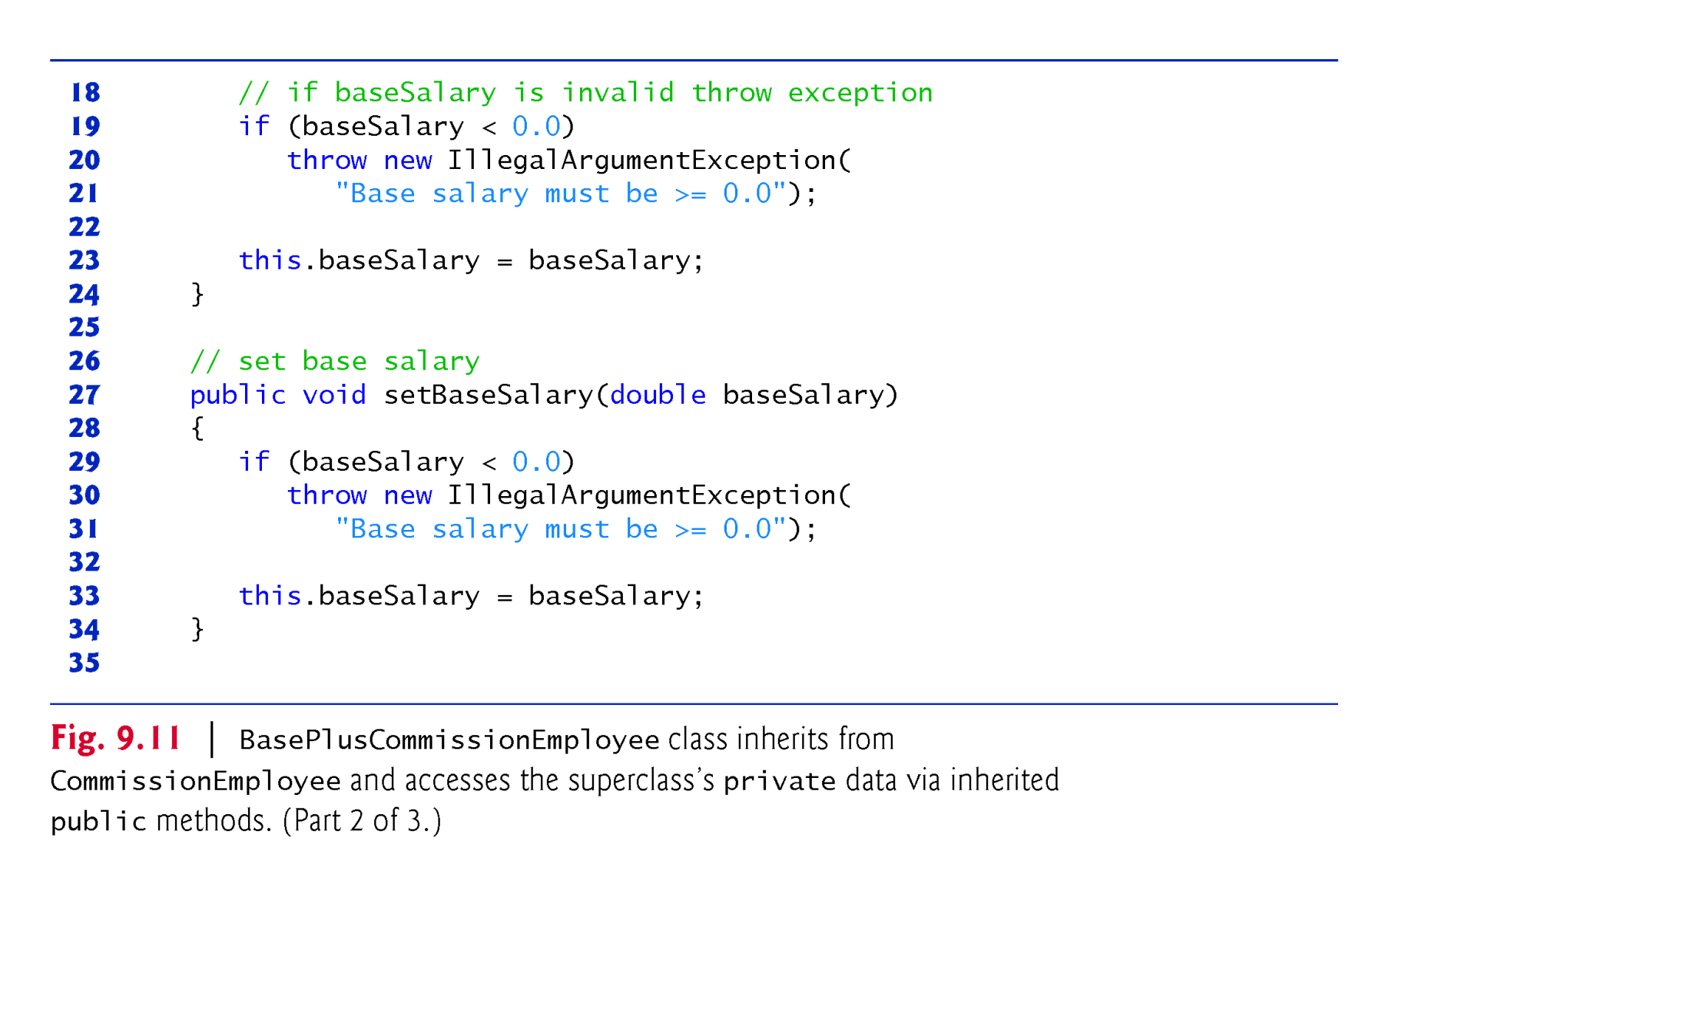
Example 5: BasePlus: Inheritance + Private(7/8)
Subclass extend superclass by adding BaseSalary and setSalary () members

Slide 35
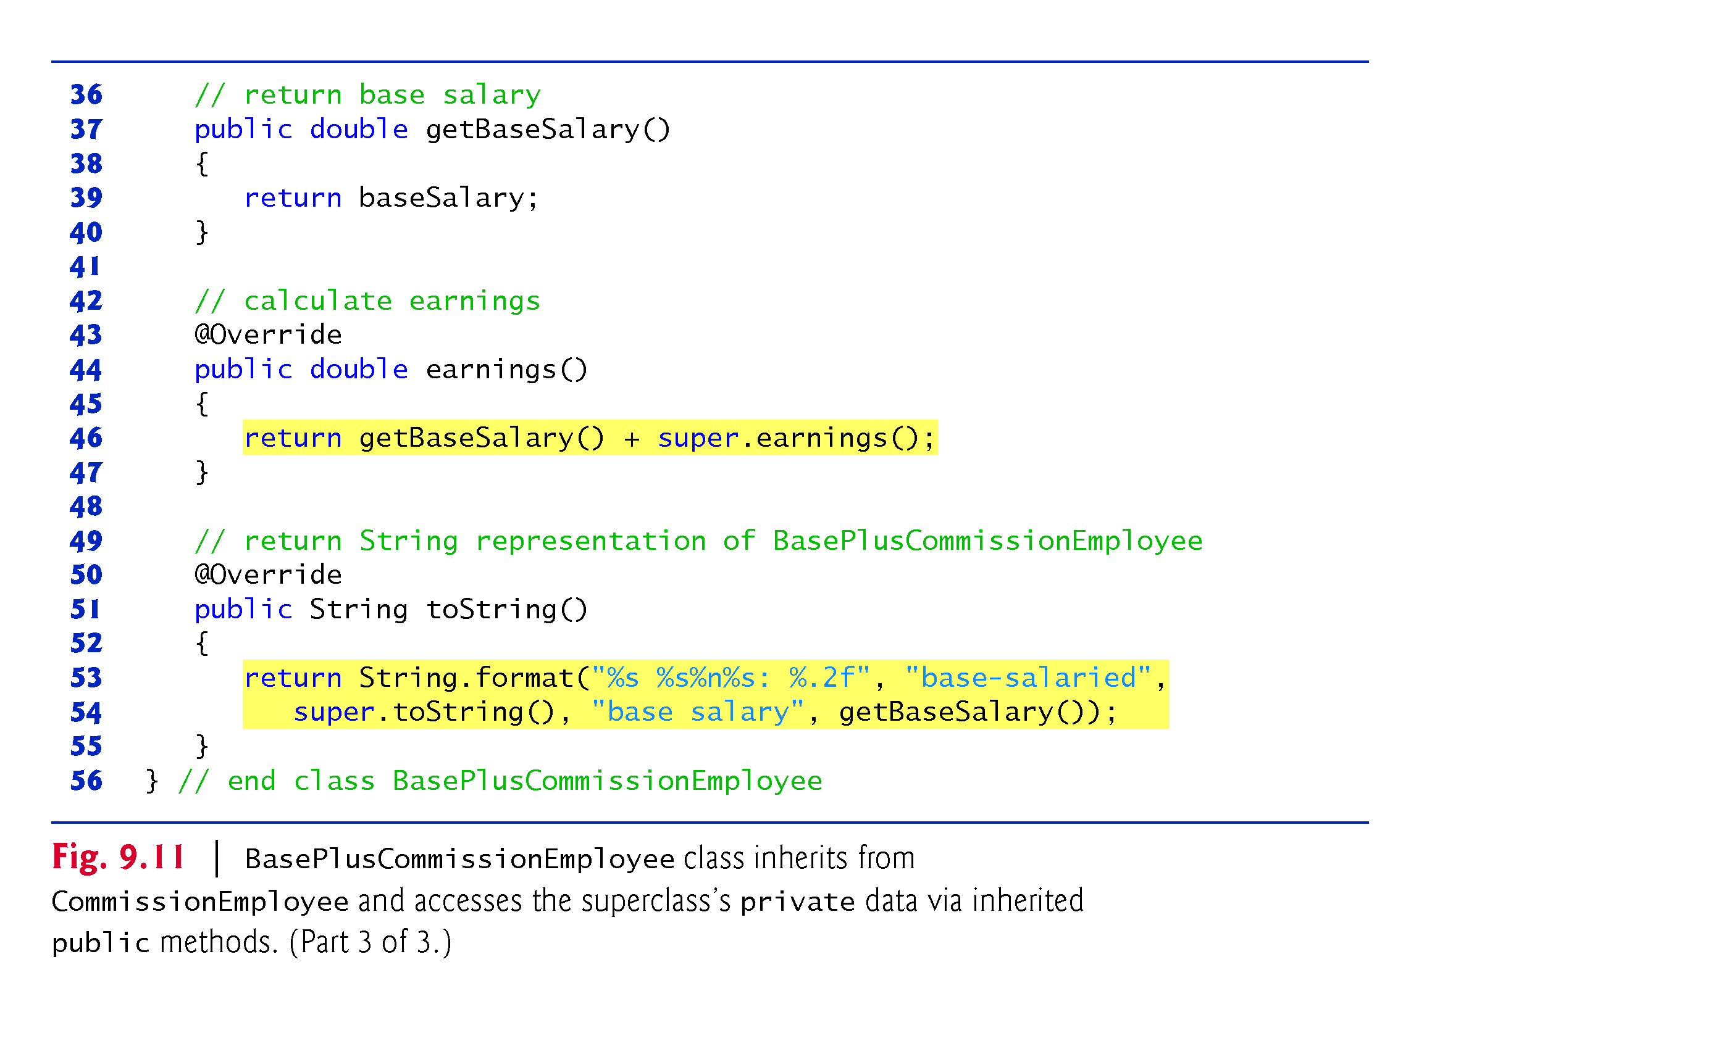
Example 5: BasePlus: Inheritance + Private(8/8)
earnigs () and tostring() are not overriding the parent method 100%.
It is extending the existing service and invoke using “super” keyword.
Note: Use Fig 9.7 as test class

Slide 36
Summary of the above 5 inheritance examples
Fig. 9.4 (normal class) and Fig .9.5( Test class)
Fig. 9.6 (normal class) and Fig .9.7( Test class)
Fig. 9.8 (normal class) and Fig .9.7( Test class)
Fig. 9.9 (normal class) and Fig .9.7( Test class)
Fig. 9.10 and Fig 9.11 (normal classes) and Fig .9.7( Test class)
Note 1: Fig. 9.11 and Fig .9.6 are two different implementations. Both implementations has the same output using as Fig.9.7 test class
Note 2: The impanation in Fig.9.11 is better than the implementation in Fig.9.6 from software engineering perspective.

Slide 37
Constructors in Hierarchical Inheritance
When we create an object a subclass using “new” operator,
the object gets space for its own member field and its inherited fields directly or indirectly until “Object” class.
Physically, multiple objects are created on heap by each constructor in the hierarchy.
Logically, one object is created with different layers as shown below: BaseSalary,FirstName,LastName,SocialSesurityNumber,
GrossSale, CommisionRate.
BasePlusCommmission
b
Commission
GS
FN
BS
Object
CR
LN
SSN

Slide 38





Constructors in Hierarchical Inheritance
Question: Can child exist before parent? NO
All the constructors in an object’s inheritance tree must run when we create object using “new” operator.
“new” operator starts the whole chain of constructors reaction.
A subclass may inherit a method which depends on the values of the member fields of the superclass.
Hence, an object to be fully created, all its superclass parts must be created by running all superclass constructors.
Hence, we will have a call-stack of constructors
Object()
↓
$↓$
$↓$
Comm()
Commission()
$↓$
$↓$
plusComm()
plusComm()
plusComm()
$↓$

